Slide 1
Technical Meeting Cookbook
IEEE National Capital Area

Slide 2
About These Slides
Organizing technical meetings is a lot like cooking
It requires quality ingredients, patience, and a bit of luck
When it works it can be very satisfying
It also takes guidance and practice
These slides help you prepare the perfect technical meeting for your chapter or council
Intended for chapter and council officers and volunteers
All organic, no refrigeration required
Don’t be afraid to add your own garnish

Slide 3
Why Cook – I Prefer Eating Out!
Many people would rather just attend conferences than learn how to plan them
Just as there are good reasons to learn to cook, there are good reasons to learn how to put on a technical meeting
Choice: pick interesting topics that interest you and locations and times that are convenient
Skills: develop the core managerial skills of planning, influencing, organizing, and controlling
Satisfaction: serving up a great meeting wins you accolades and make you feel proud

Slide 4
Overview
Ingredients
Topic
Speaker
Date/Time
Venue
Food
Promotion
Cost
$100-400 depending on the location and number served
Paid or reimbursed by the chapter or section
Time
5-6 hours preparation over the course of a few weeks*
2-3 hours day of the meeting
30 minutes follow up
* Preparation times may vary; the first one may take longer

Slide 5
Before You Begin: Kitchen Staff
Put together an informal program committee
It can be done by one person, but even one additional doubles idea diversity, adds redundancy, and reduces individual workload
Usually includes chapter chair, but vice chair, treasurer, and anyone else interested should be encouraged
Ideal program committee members
Understand the chapter/council technology and either have or are willing to seek related local contacts
Are organized and methodical
Have time, are responsive and enthusiastic

Slide 6
Assemble The Ingredients
Getting the ingredients may take more time than cooking
Plan to send email, make phone calls, and ask people in person
All the ingredients are available on store shelves in your section
But you can import from anywhere
Some can be a little harder to find, but help is available
There are choices for every item
Substitutions are allowed
Great chefs experiment!

Slide 7
How To Pick A Good Topic
Must be relevant
Directly related to the chapter or council
Should be fresh
The focus of recent news articles, special magazine issues
Optionally sprinkle in aged topics that or classic or have recent progress or relevance
Different ones month to month
Some restaurants vary their entrees to avoid getting stale
Must have speakers willing to talk about them

Slide 8
Gourmet Topics
Great topics often lend themselves to a three-part flow
Context: Describe the environment in which the talk takes place. Define acronyms and buzzwords. Assume attendees know the topic is important but lack specialized knowledge.
Problem: Explain why something desirable is hard. Does functionality not exist? Does it not scale? Is it risk? Give data.
Solution: Lead the audience to the resolution. Discuss dead-ends and highlight major insights. Quantify the benefits.

Slide 9
How To Pick A Speaker
Must be knowledgeable and a good presenter
Often someone with unique access and/or ten+ years of experience
Speaks clearly, organizes well, enthusiastic, and answers questions directly and concisely
Exception: okay to occasional develop student presenters
May be an IEEE member
If they aren’t when they start sign them up!
Fame doesn’t hurt
A big name can increase attendance

Slide 10
Where To Find Good Speakers
There are many ways to locate prospective speakers
Work relationships
Local IEEE Members (especially Senior Members, Fellows)
The Distinguished Lecturer Program
Societies have lists of experts; they often pay travel
http://www.ieee.org/about/volunteers/tab/distinguished_lecturer_program.html
Cold calls
See someone at a conference, in an article, TED Talk, YouTube
Stuck? Ask your section chair or other officers and directors for help

Slide 11
Date and Time
Target dates when you can get a good turnout
Midweek is most common, but Saturday may work for some
Avoid holidays and other IEEE events
Check section calendars for conflicts
Pick times suitable for your target audience
Many technical talks are held evenings starting 6 pm
Some talks that draw more students and retired individuals may be held Noon – 1 pm

Slide 12
Venue Menu – Appetizers
There are many places where meetings can be held in Northern VA and Washington
Teqcorner in McLean, VA holds 35-70 people
Up to 8 hours/month paid by Northern VA
Metro accessible, but BYO projector
Many libraries offer free public meeting rooms for 20-30
Reserve in advance - first come, first serve
Some restaurants will provide a private room for 20-30
Food can be expensive and service interrupts flow
Chapters/councils that serve both areas should plan meetings in DC, MD, and VA

Slide 13
Venue Menu – Main Courses
Companies have provided great facilities in the past
Must allow non-citizens access, but it’s okay if they require advance registration
Recent security concerns have curtailed participation
Section leadership has contacts at many local colleges and universities
GWU, George Mason, Marymount, UDC, Umd, Montgomery College, NVCC, Stevens Institute, DeVry, Georgetown
Some facilities will rent space as needed
Lyceum in Alexandria charges $100/hr
These are best for expected audiences of 50+

Slide 14
Venue Menu – Desserts
Request WebEx for live streaming
Supports both broadcast (1-way) and interactive
Must request in advance from IEEE
http://www.ieee.org/about/volunteers/remote_conferencing/index.html
Record the presentation for viewing later
Northern VA has microphone for audio and Camtasia for screen capture, editing, and optional video

Slide 15
Food Encourages Attendance
Make sure there’s something to eat
You can charge for the meal or have people pay their own at a restaurant
If the chapter pays then just about anything goes
Pizza, sandwich platters, box meals
Fast food, local restaurant chains, grocery stores
Many will provide small discount if you ask
Offer guest speakers something a bit nicer

Slide 16
Combine Above Ingredients
Put above ingredients into bowl and mix well
Find speaker to cover topic
Make sure a venue is available and allows food
Verify speaker and venue are available on the date
Ensure budget will cover food, DL gift/lodging/dinner
Helps to have multiple chefs
Perform this step ideally 30+ days in advance
Once it sets up put it aside
Check on it once in a while to make sure nothing changes

Slide 17
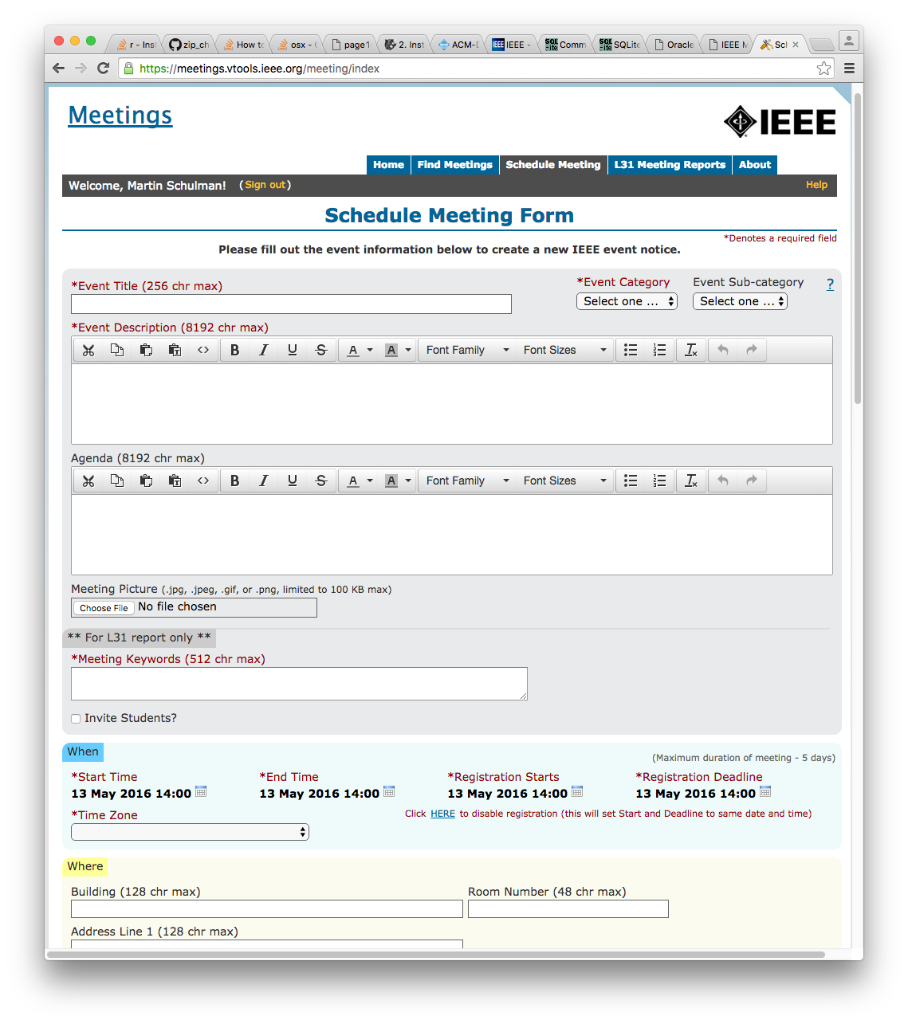
Promotional Seasonings
Enter meeting in vTools
Easy to use web interface
Gathers all information
Supports registration, payment, special request tracking
One entry/event
Automatically populates Northern VA and Washington web calendars
Guidelines available
http://sites.ieee.org/nova/resources/communication/event-post-guidelines/

Slide 18
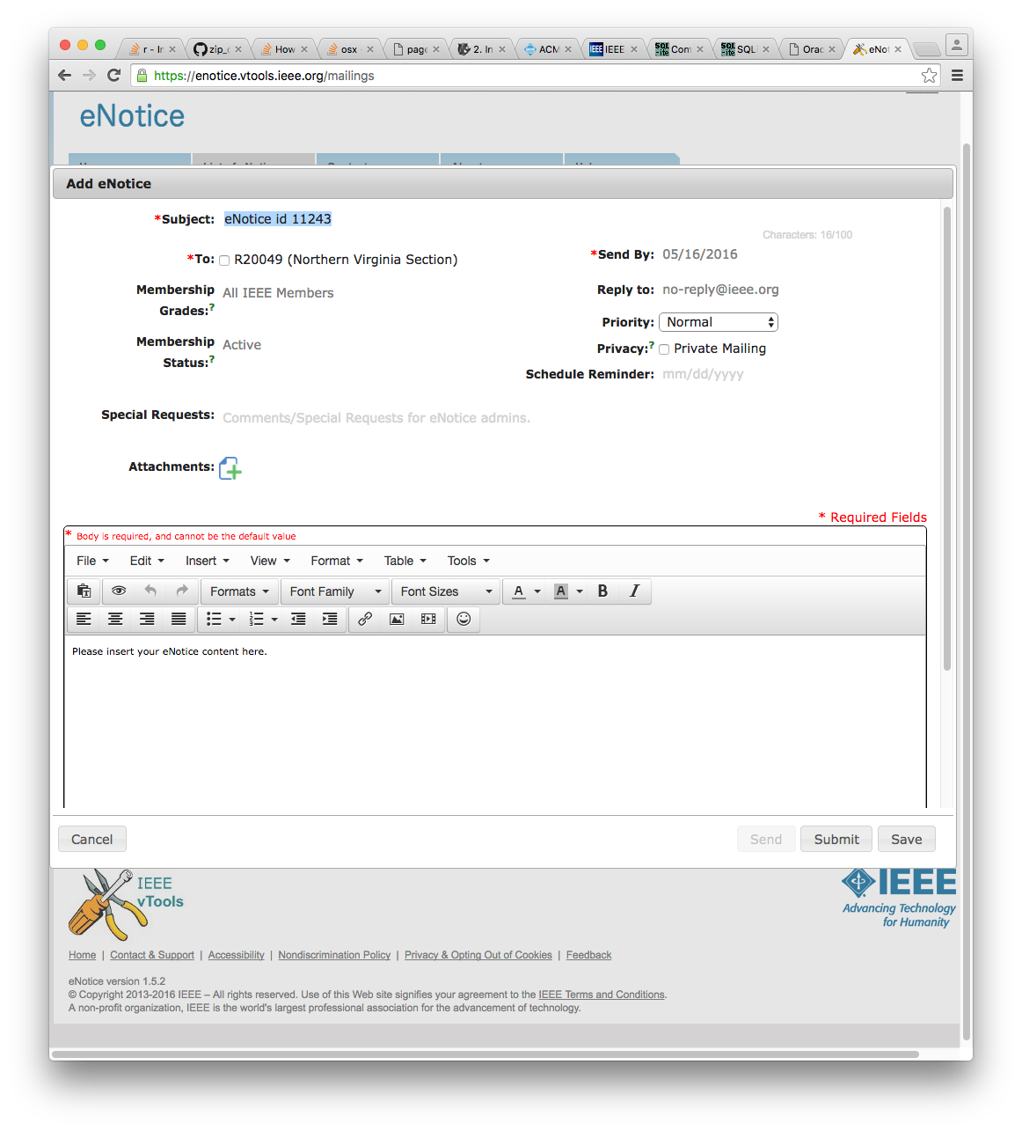
Promotional Seasonings
Send eNotice
Easy to use web interface
Sends nicely formatted to opt-in chapter members
Express feature sends in a few hours and shows recipient count
Once far in advance, again close to meeting date
Training available
http://sites.ieee.org/vtools/files/2014/05/eNotice-Published.pdf

Slide 19
Following Directions
If someone tries but cannot find your meeting...
They may NEVER give you another chance
Provide clear, detailed travel instructions
Specific building address, room number
Special notes for places that are hard to find
Parking options and traffic/construction warnings
How to determine if event is canceled (i.e. weather)
In vTools listing and eNotice announcement

Slide 20
Promotional Gravy
Notify related chapters in advance
They can co-sponsor and receive meeting credit
They must NOT create a separate vTools event, but they DO need to send eNotices to their members
Notify Northern VA and Washington section chairs
They can promote to entire membership
Can also help notify adjacent section chairs if appropriate
Be creative!
Promote via YouTube, Facebook, Twitter
Tell work colleagues

Slide 21
Setting The Table
Before or day of the event
Confirm with the speaker
Take DL’s from out of town to dinner – chance to talk
Check room is still available and unlocked
Make sure AV equipment is functioning or there is backup
Verify food will be ready and delivered
Create a sign-in sheet
Request emails and ask attendees if they are members
Get somebody to snap some pictures (phone okay)
Optional: purchase small gift for special speakers or invite them to dinner before or after

Slide 22
Host The Event
Arrive early so you can start on time
If you run late so will future attendees
Make sure room is set up
Put out/circulate sign-in sheet and remind people to use it
Greet new people
Introduce the speaker
Keep the talk moving
You are the MC! Pull people out of rat holes
Record unanswered questions

Slide 23
Immediately After
Thank everyone who contributed
Especially the speaker
Present the speaker with a small gift or take to dinner if you didn’t already
Collect sign-in sheet
Ensure the room is in good condition
Discard trash, return furniture, turn out lights, etc

Slide 24
Within A Few Days After
Follow up on any questions
Thank those who helped
File L31
Pull up meeting report and create from existing
Request copies of the photo
Post on chapter or section web site
Send info about IEEE to people who asked
Or ask membership committee

Slide 25
Apéritif
If:
You have ever been very, very glad you attended a talk and wanted to return the favor
You have ever regretted attending a talk and felt you could have arranged a better one
You never attended a talk because there wasn’t one you wanted to hear
...then consider arranging one. Your section leaders will help, and you might be glad you did.
nova.chair@ieee.org tony.ivanov@ieee.org

Slide 26
Questions?

