Slide 1
Engineers and Public Policy
December 11, 2018
Russell Harrison
Director of Government Relations, IEEE-USA

Slide 2
Notes from the Election
Unusually large number of very close races
Continued decline in ticket-splitting
Only one state legislature split (Minnesota)
Fewer unusual occupations
Campaigns keep getting more expensive – and money seems to matter less
And … the 2020 Election has already started!

Slide 3
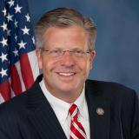
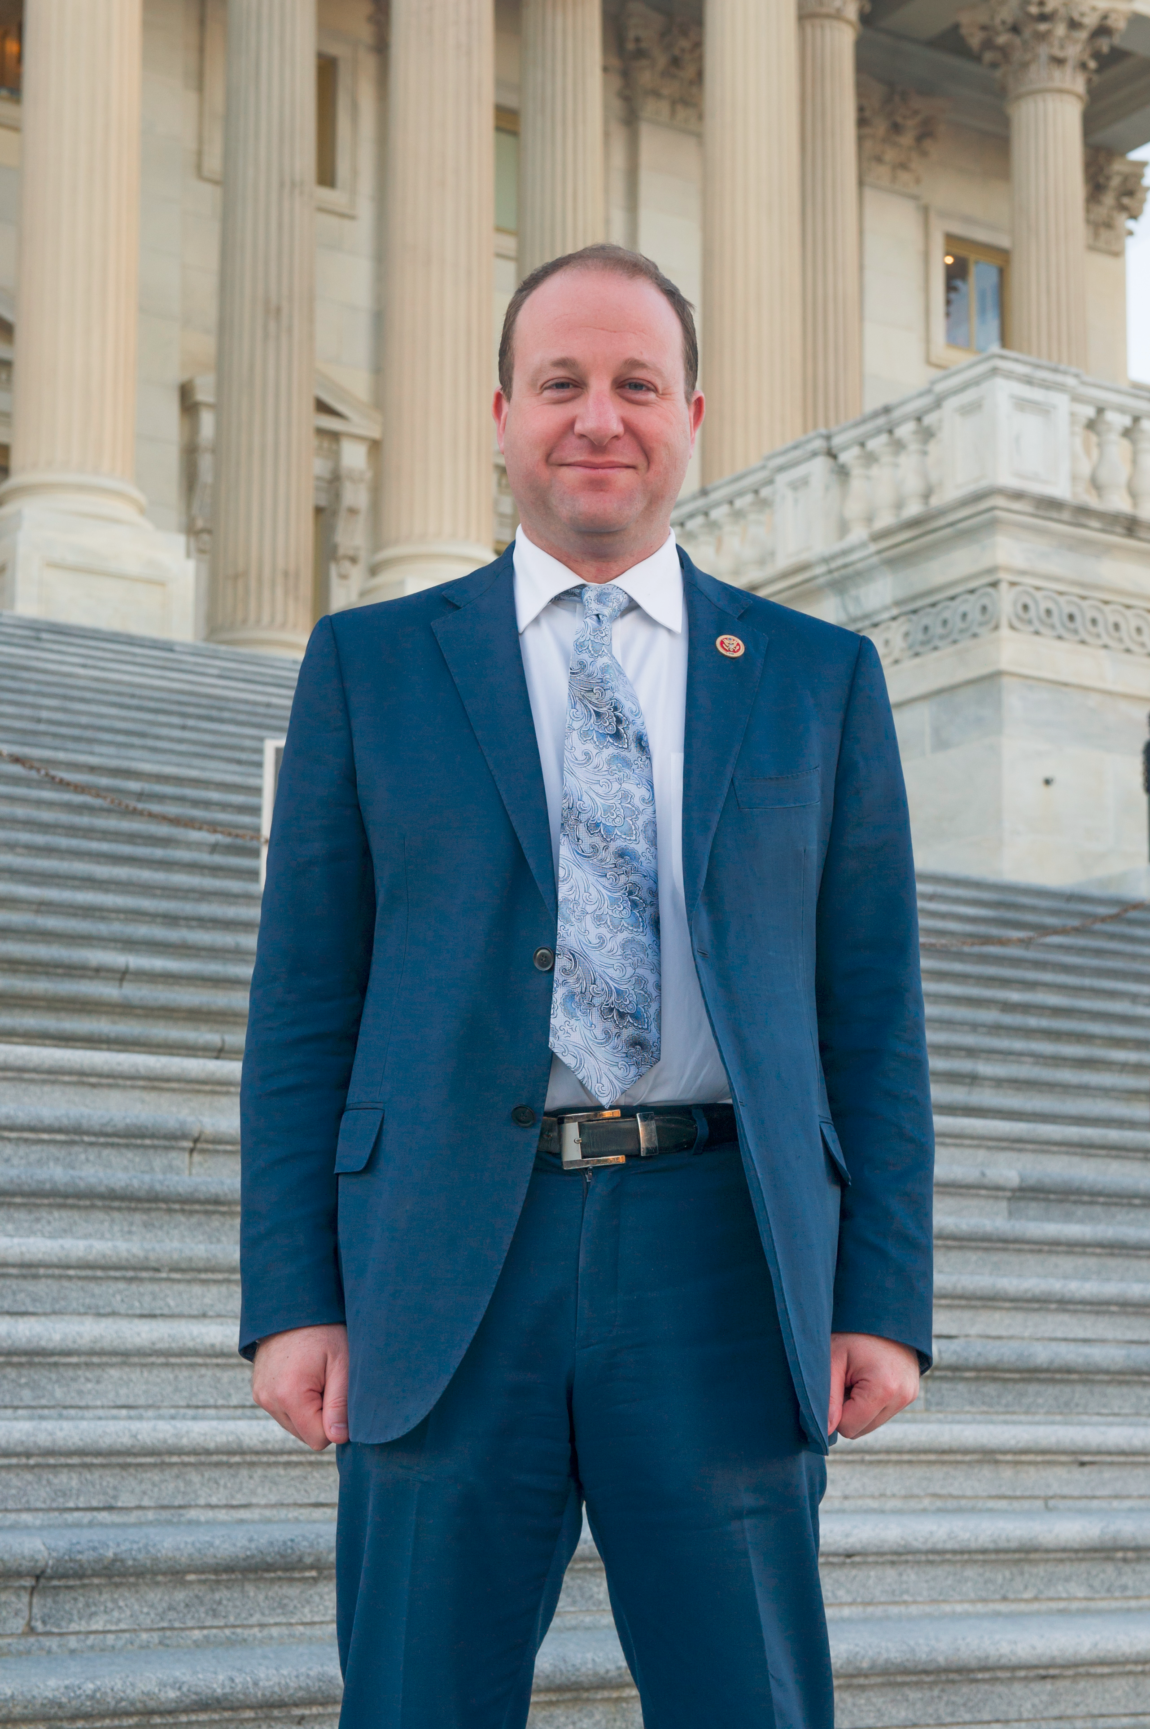
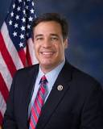
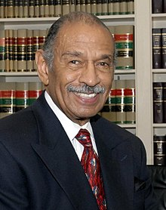
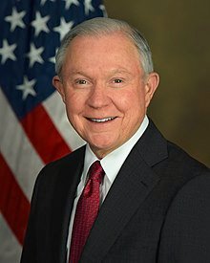
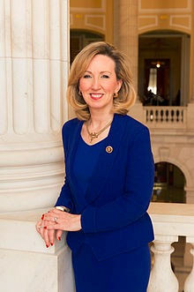
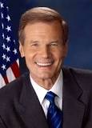
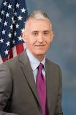
What does the Election mean to IEEE?
Loss of key friends:
Rep. Randy Hultgren (R-IL)
Rep. Jared Polis (D-CO)
Rep. Raul Labrador (R-ID)
Rep. John Conyers (D-MI)
Sen. Jeff Sessions (R-AL)
Rep. Barbara Comstock (R-VA)
Sen. Bill nelson (D-FL)
Rep. Trey Gowdy (R-SC)

Slide 4
What does the Election mean to IEEE?
Several allies on R&D funding gone, but new Congress should be more sympathetic
Several allies and opponents on immigration gone, might open up new opportunities
New leadership on all House Committees
But …. Increased partisanship doesn’t bode well for anything.

Slide 5
2019 Legislative Agenda

Slide 6
Space Policy
NASA has been adrift for years
High-level review of NASA’s purpose in the White House
Space Force (maybe)
Two years is a long time for a high-level review
Basic challenge: Is NASA a …..
Research organization?
Exploration organization?
Inspirational organization?
If it is all three, it is nothing

Slide 7
Immigration Policy
Green Cards, not Guest Workers
Tech companies will push for more H-1B visas
IEEE-USA will push for more green cards
House Democrats will push for a comprehensive immigration bill. They will not get it.
Republicans will push for more immigration enforcement
Stalemate, again?
Administrative efforts continue

Slide 8
IEEE-USA Agenda
Energy reform:
Rural electrical grid
Small modular nuclear reactors
Alternative energy
Intellectual property: Small and independent inventors
Advanced technologies: Artificial Intelligence, quantum, block chain, cybersecurity
Internet Bill of Rights

Slide 9
What do Lobbyists Do?

Slide 10
What do Lobbyists Do?
Advocate Positions
Bridge between voters and politicians
Research
Problems & Solutions

Slide 11
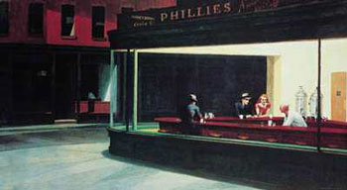
Politicians listen to lobbyists because voters don’t talk to them.

Slide 12
Democracy is a Participatory Sport

Slide 13
Our challenge!
Running for office is getting more and more expensive …. And we don’t give contributions
More and more groups are engaging in advocacy …. And we have limited staff
Congress is tackling more and more technology issues … and we have not adapted

Slide 14
What can we do?
We need to create authentic and meaningful interactions with legislators, without …
Spending more money
Requiring more staff time
Congress and IEEE need IEEE members to talk with Members of Congress

Slide 15
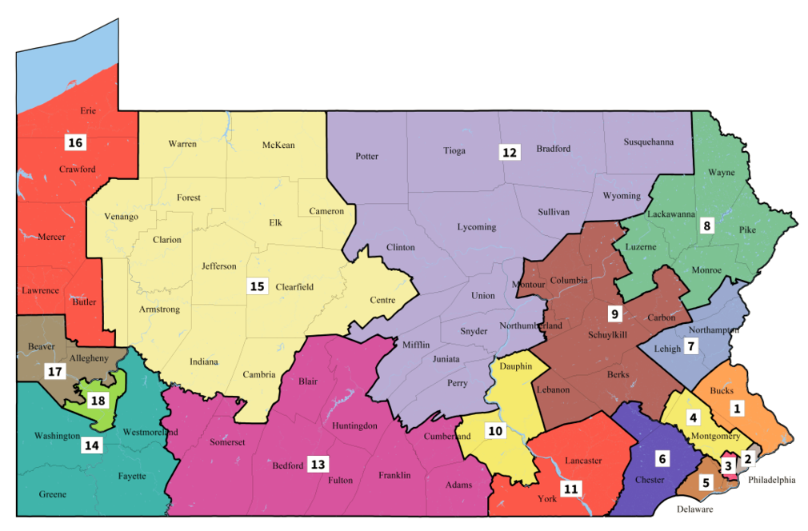
Dan Meuser (R)
Susan Wild (D)
Madeleine Dean (D)
John Joyce (R)
Mary Gay Scanlon (D)
Christie Houlahan (D)

Slide 16
But what if I get it wrong?
Everyone, Before they Start
“Wrong” is not speaking up.
Anything else is right.

Slide 17
Russell Harrison
r.t.harrison@ieee.org
(202) 530-8326

Slide 18
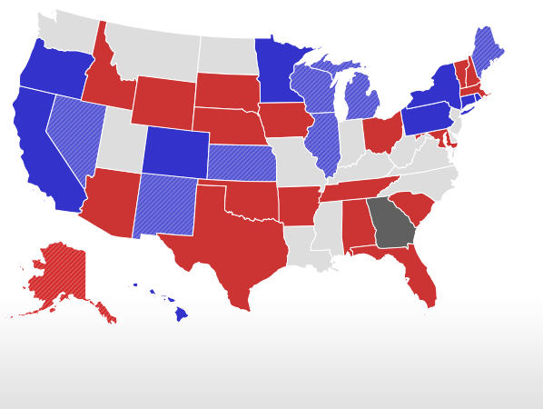
Other results
Democrats pick up 7 Governorships, but Republicans still have advantage 27 to 23
Democrats did well in the Mid-West
Republicans hold several Blue states
Democrats picked up seven state legislative chambers
Republicans completely control 21 states, down 5
Democrats completely control 14 states, up 7
Dems won back one-third of state seats lost under Obama

Slide 19
Actions that have “some” or “a lot” of
influence over a legislator’s vote
Congressional Management Foundation

Slide 20
China
Deemed Exports
Fundamental Research Rule
Emerging technologies
Expanded List of Industries
Expanded restrictions within industries
Expanding list of covered activities
Restrictions on Chinese Students
Cybersecutirity

